Slide 1


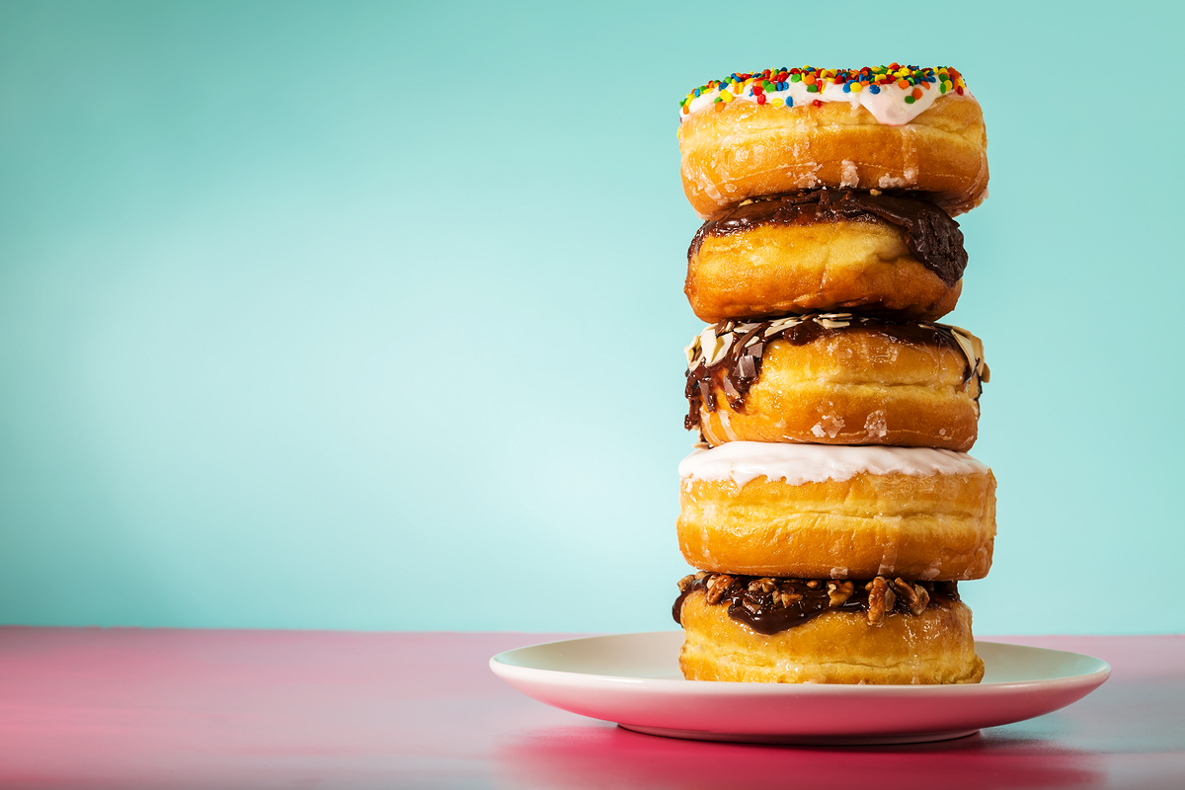

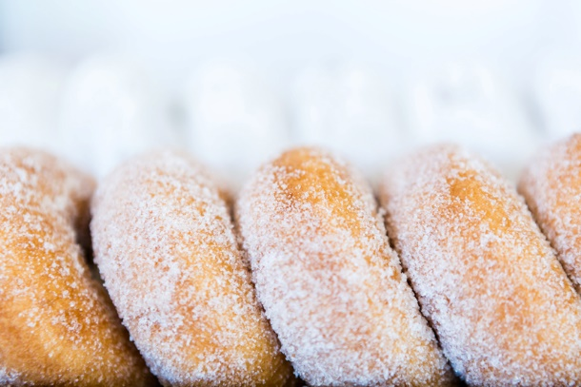
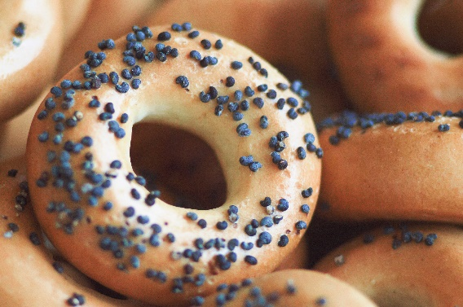
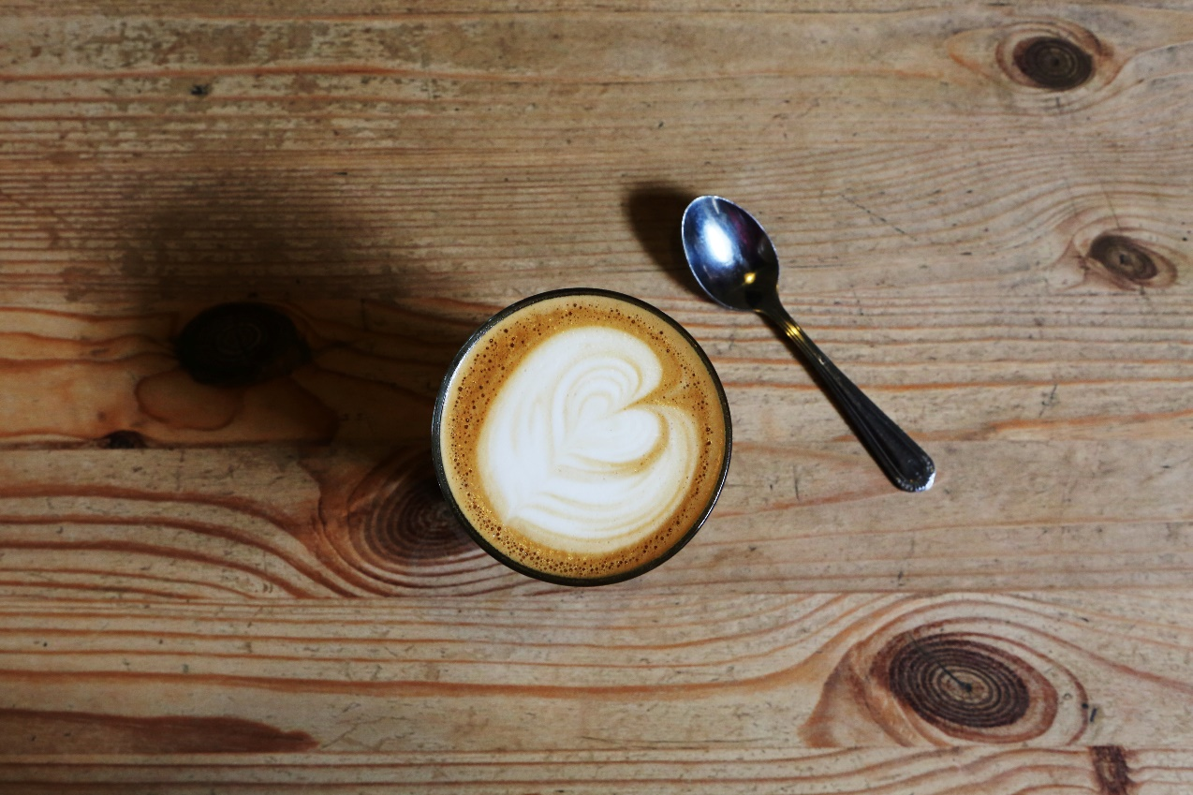
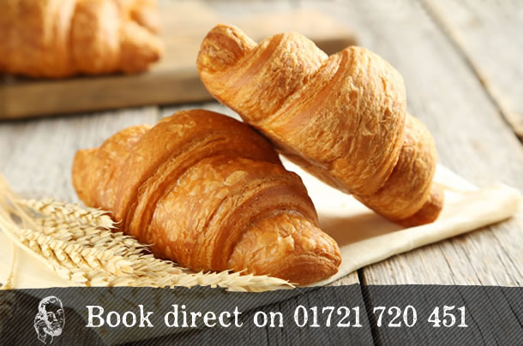
Home About Us
Menu Contact Us
Happiness is
Donut-shaped!
The finest in breakfast treats and coffees since 1971
Donut Delights has been serving C-U with the highest quality donuts and coffees since 1971. Nestled in downtown Urbana, Donut Delights has become a haven for “Gotta have it” breakfast treats. Our donuts are baked fresh twice daily and our coffee’s brewed every fifteen minutes. If you have never been to C-U’s hidden gem then you are missing out.
Gotta have it!

Slide 2
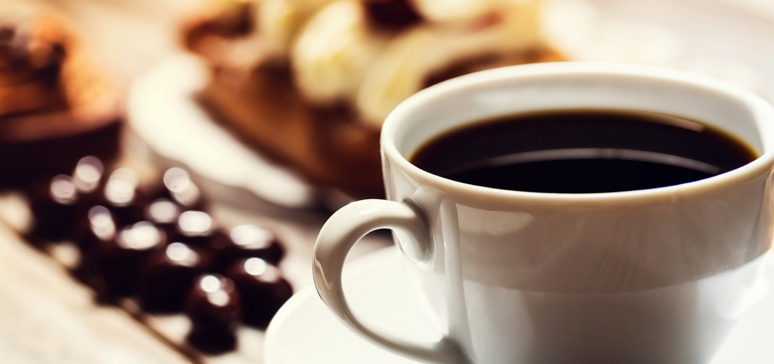
Home About Us
Menu Contact Us
Right Coffee at
the Right Time!
The finest in breakfast treats and coffees since 1971
Donut Delights has been serving C-U with the highest quality donuts and coffees since 1971. Nestled in downtown Urbana, Donut Delights has become a haven for “Gotta have it” breakfast treats. Our donuts are baked fresh twice daily and our coffee’s brewed every fifteen minutes. If you have never been to C-U’s hidden gem then you are missing out.
Gotta have it!

Slide 3
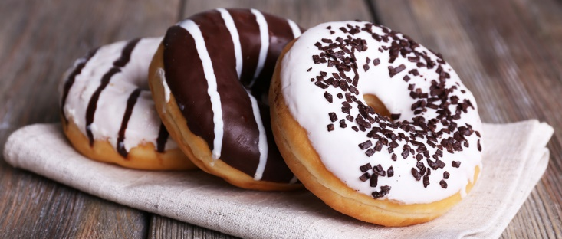
Home About Us
Menu Contact Us
Gotta have it!
The finest in breakfast treats and coffees since 1971
Donut Delights has been serving C-U with the highest quality donuts and coffees since 1971. Nestled in downtown Urbana, Donut Delights has become a haven for “Gotta have it” breakfast treats. Our donuts are baked fresh twice daily and our coffee’s brewed every fifteen minutes. If you have never been to C-U’s hidden gem then you are missing out.
Gotta have it!

Slide 4


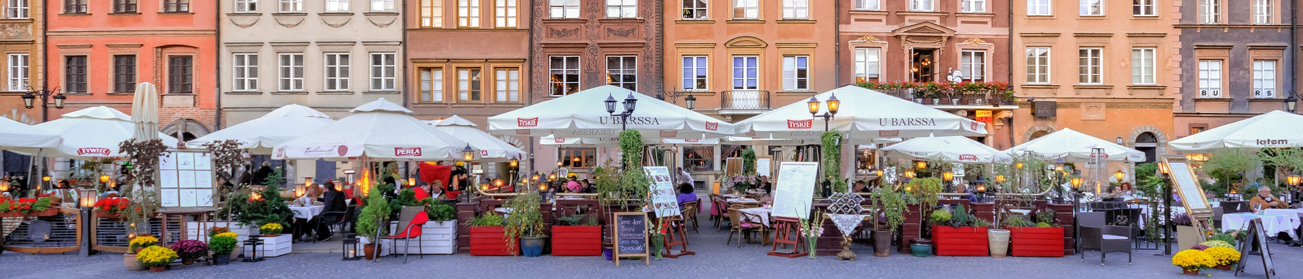
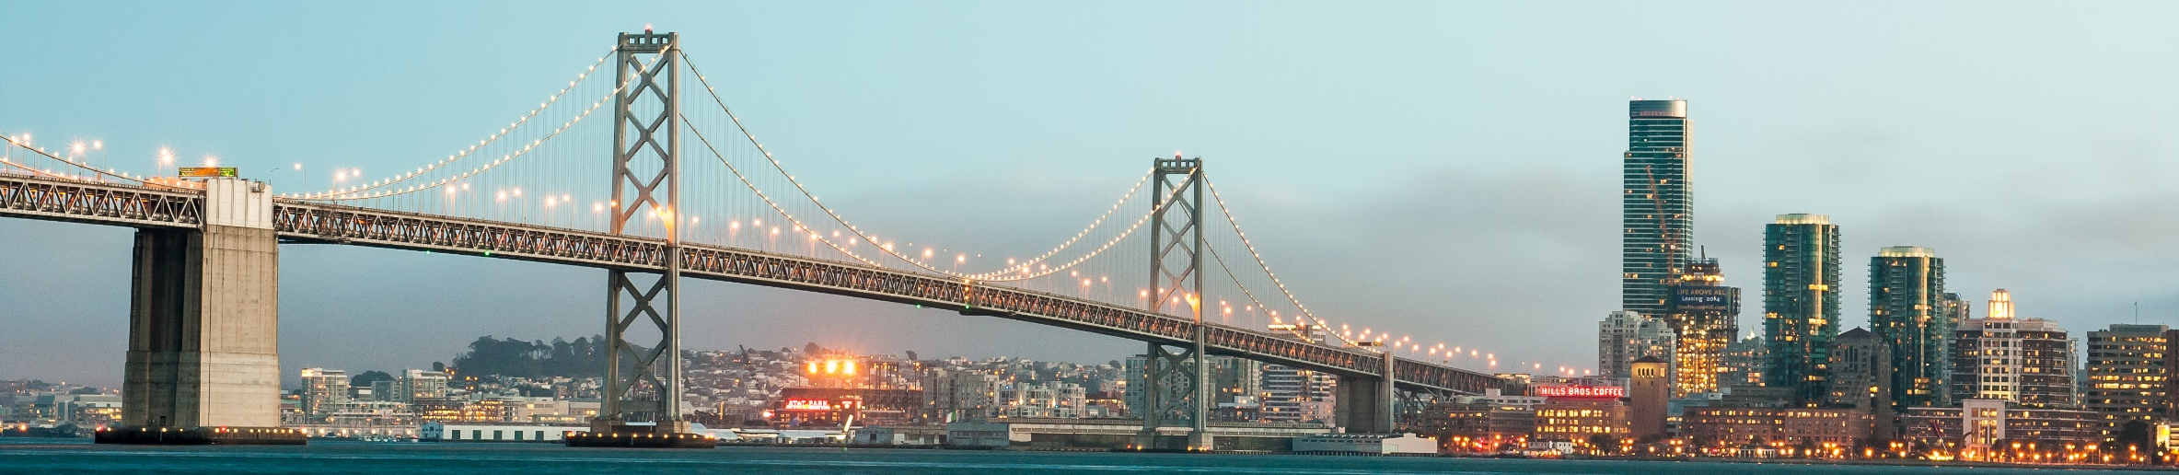
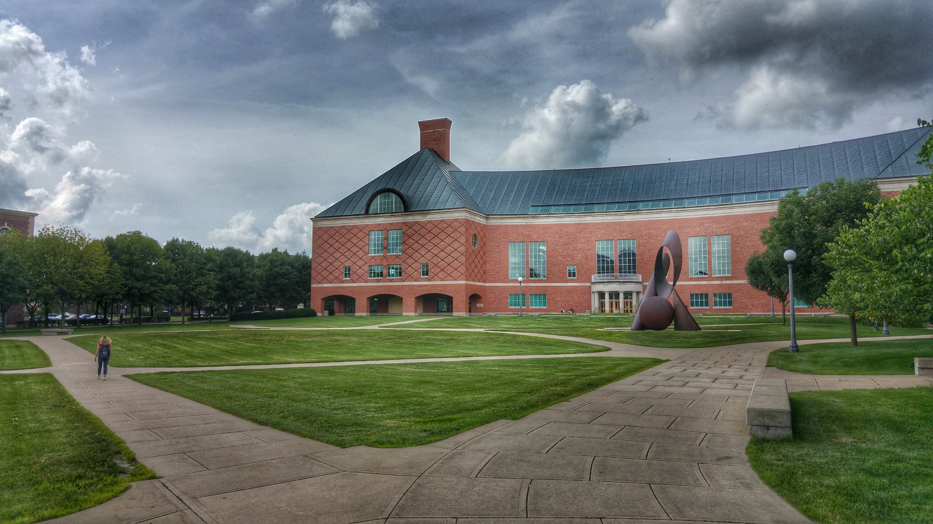
Home About Us
Menu Contact Us
the
Poland
In 1971, an immigrant baker named Melvin Furballski from the far east coast of Poland landed in New York City and by chance he found an open seat on a bus heading west.
When an unexpected mechanical failure forced a three day delay in Champaign, Illinois, Furballski saw the need for a donut shop and decided to stay. Here with only one hundred dollars and an abandoned breadshop, he made one of a kind donuts flying off the racks faster than he could bake them and things have never slowed down.
Now you can find that same great donut recipe plus dozens more still being made with the same love and care as when Donut Delights first opened.
New York City
C-U
Donut Delights’ Journey
WAW
NYC
CMI

Slide 5
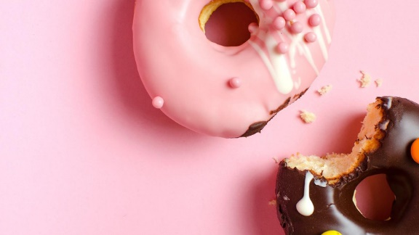
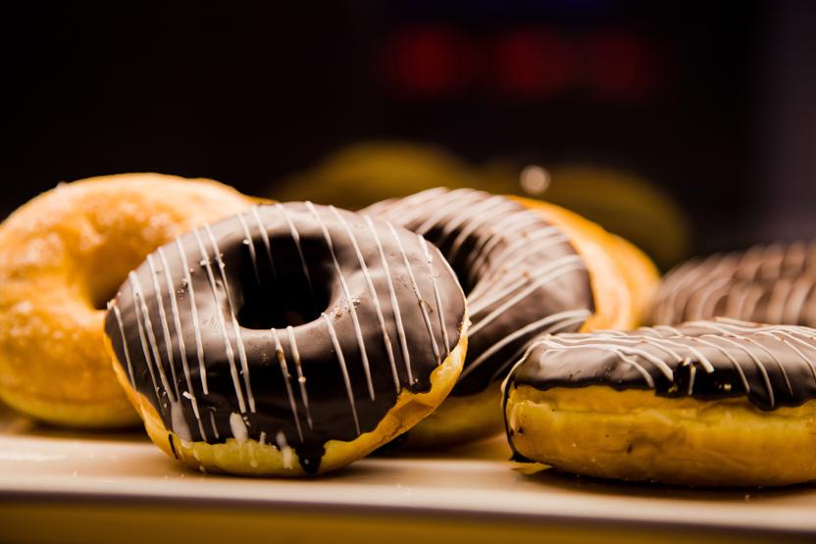
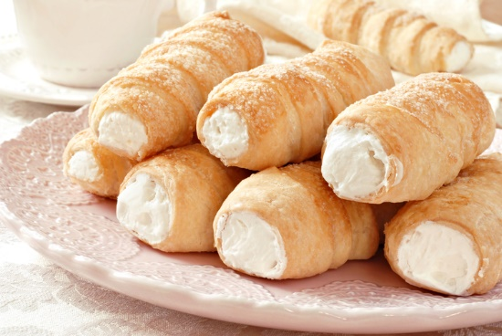
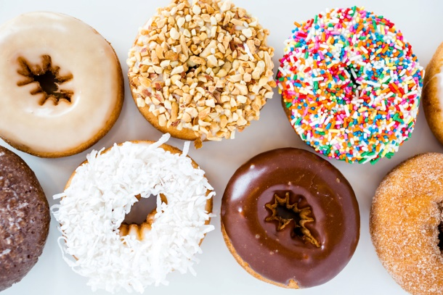
Home About Us
Menu Contact Us
Our Menu
Fancy Donut:
bow tie, éclair, apple turnover, fancy coffee roll
Top sellers:
Pistachio Pinwheels
Boston Cream delights
Chocolate confetti
Marshmallow Mayhems
French twists
Bulls Horns
Regular Donut :
chocolate frosted, vanilla frosted, boston cream, jelly filled, cream filled, glazed, chocolate glazed, marble twist, sugar raised, plain donut, plain cruller, honey wheat, jelly puff, cream puff, coffee roll

Slide 6
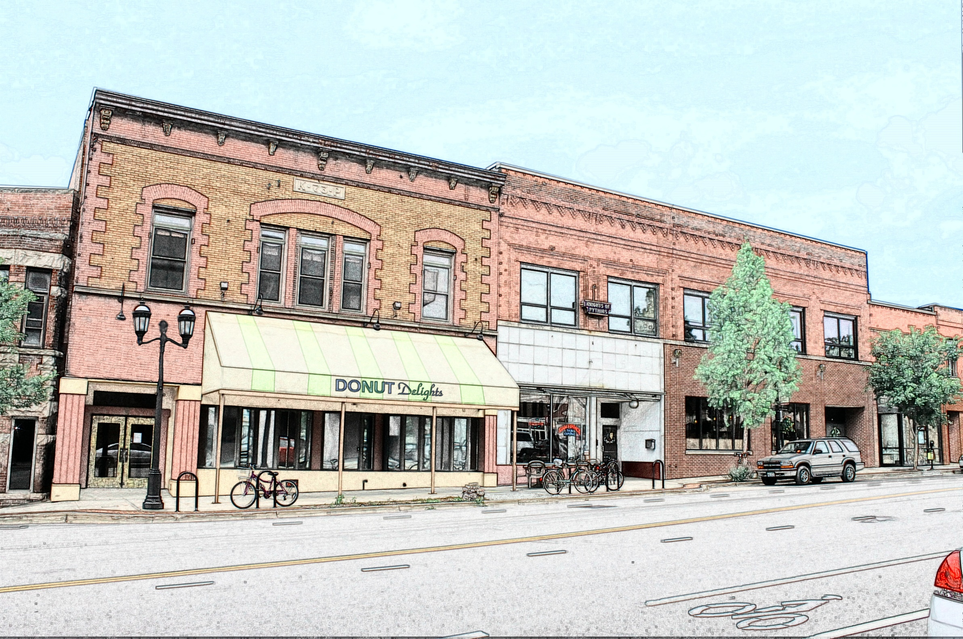

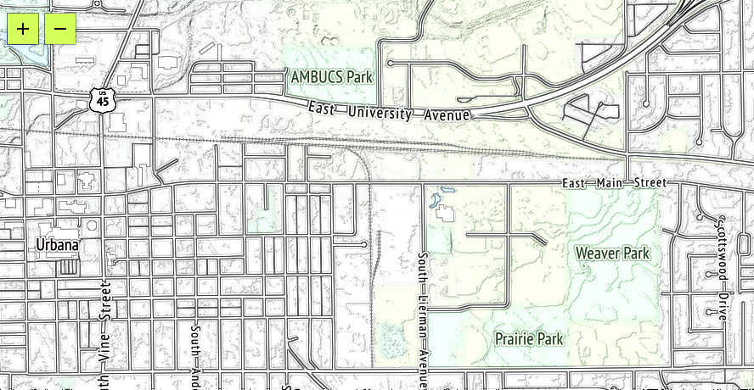



Home About Us
Menu Contact Us
Visit Us!
Subscribe to our newsletter for the latest on our seasonal offerings and special events!
Email:
Comments:
Address:
Donut Delights
2112 main street Urbana ,
Illinois 61801
(217)-555- 1234
Email: contact@donutdelights.com

Slide 7
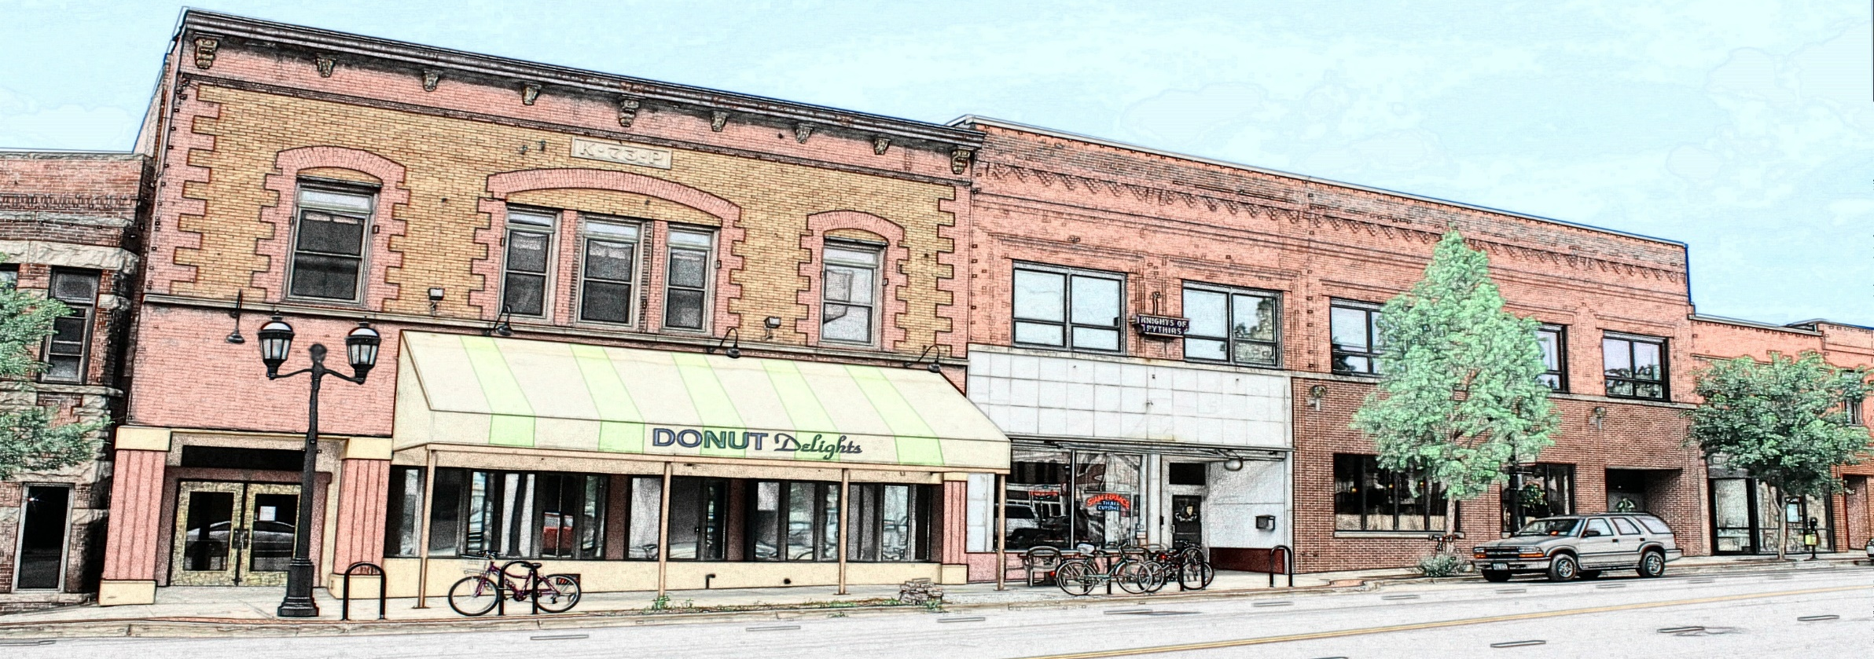
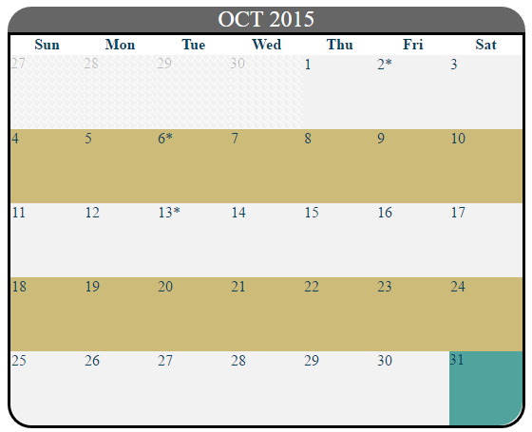




Home About Us
Menu Contact Us
Visit Us!
Subscribe to our newsletter for the latest on our seasonal offerings and special events!
Email:
Name:
Comments:
Submit
Address:
Donut Delights
2112 main street Urbana ,
Illinois 61801
(217)-555- 1234
Email: contact@donutdelights.com

